Slide 1
AlgorithmicEngineering Marketing
An algorithm to change your life

Slide 2
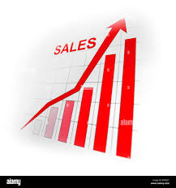
Mission
Improving a company's resources by eliminating small profit margins from sales that are close to the break-even point.

Slide 3
Objective
Develop an algorithm that integrates technologies with aspects of probability and statistics, marketing, digital sales, engineering, and business strategy.
Evaluate data through calculations, graph creation, market research, and strategic decision-making focused on exceeding prior sales results. This methodology can elevate sales past the break-even threshold, resulting in significant profit enhancements, particularly for companies with a high proportion of fixed costs and only a few variable costs related to sales volume.

Slide 4
What precisely is an algorithm?
An algorithm acts as a resolution that combines qualitative and quantitative aspects, developed by a person with the support of a computer. In this case, we utilize Microsoft Excel to enhance the decision-making process.

Slide 5
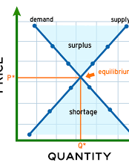
What is meant by the terms equilibrium point and break-even point?
Defines a state of balance within a market where the amount supplied aligns with the amount demanded, leading to consistent prices and quantities.
The point at which total revenues are equivalent to total costs, resulting in zero net profit. Essentially, the breakeven point signifies the level at which a business starts to make a profit.

Slide 6
What’s needed?
To effectively gather the necessary data and create a comprehensive database, it is crucial for us to obtain all your sales records in the most efficient way possible. This will aid in devising a cost-effective project designed to boost the company's profits and overall effectiveness.
Additionally, we need access to the specifications for the products and services provided.

Slide 7
What is a data base?
Within this framework, a database includes all sales record information structured within a business model, which can be examined to generate predictions utilizing probability, statistics, and calculations of market potential. This examination can promote profit enhancement through visual displays, metrics, and qualitative evaluations of the collected data.
The database contains all essential information required to develop a business model that improves an organization's standing in its desired market.
It acts as a crucial base for making data-driven decisions intended to increase sales through marketing initiatives and engineering strategies.

Slide 8
How the algorithm works?
We employ Excel to develop formulas, forecasts, and visual representations from the generated database, which aids us in making informed decisions based on the demand-supply dynamics of available rooms over various timeframes, thus allowing us to enhance profits throughout the year.
The computer will execute calculations that require precise evaluation to identify the most effective marketing strategy, ensuring the business can effectively position itself in the market and maximize sales potential for the facilities.
While there is one clear strategy for achieving optimal occupancy rates for the business, this decision must be meticulously crafted based on all available information.

Slide 9
What we offer?
A very attractive price to the market, that according to Engineering costs of data management related, marketing surveys, match with own developed prizes.
An incomparable capacity business minded set up.
A data sheet that will have instructions of how to make work at it’s best digital sales.
The algorithm with logical explanation.

Slide 10
Why differ from the competence?
This is a new concept of business management, that according to ordinary marketing surveys, this one includes Engineering.
Normal Marketing surveys and Marketing techniques although effective they are not accurate at the moment of targeting goals to the maximum capacity, due to the lack of engineering in their measures.

Slide 11
Digital Sales
Digital sales have transformed our world. Advances in internet technologies have enhanced their functionality, prompting businesses to adapt in order to remain accessible and user-friendly for customers.
Currently, digital sales account for a significant portion of all sales, largely due to the ease of access customers have to information.

Slide 12
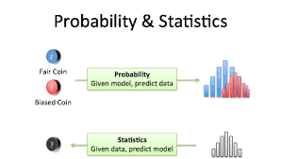
Probability and Statistics
Although sales can vary over time, there are reliable signs of consistent trends. A straightforward example demonstrates that the hospitality sector goes through both high and low seasons.
We leverage these indicators for both regular and one-time events, which enhances our understanding of the information. For example, we can evaluate the number of rooms sold compared to those unsold within a specific period. By taking into account different elements such as room category, pricing for each booking, and supplementary services, we can transform this data into valuable quantitative and qualitative insights, guiding us toward significant indicators.

Slide 13
ROI
ROI (Return on Investment) denotes the time it takes to recover your initial investment.
The ROI can vary depending on the company and its capacity to increase sales within a specific period.
In this case, the organization may expect a potential increase in utilities that could be as much as double.

Slide 14
Model of business
Typically, every business seeks to identify a target market, which involves selecting from the vast array of market segmentation to find products that meet consumer demand. For instance, factors like the capacity of hotel rooms, their size, and additional features can influence this selection.
This process aims to enhance the alignment between product supply and consumer satisfaction, ultimately boosting sales through improvements in the digital sales strategies that a business can implement.

Slide 15
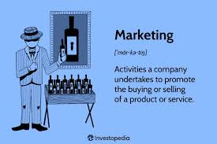
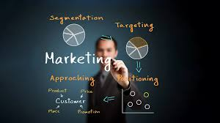
Marketing
This includes all the factors that potential clients are likely to evaluate. These criteria comprise various elements, and different marketing strategies will affect how offerings are presented to the market to attract both consumers and business owners.
In the decision-making process concerning the business model, it is essential to consider both internal and external factors to ensure the organization can fulfill the majority of the supply capabilities required to meet prospective customer needs and effectively respond to market demand.
Market trends can consistently be monitored, and through the use of statistical analysis, we can obtain insights into market dynamics and forecast how product segmentation may change based on what the organization has available.

Slide 16
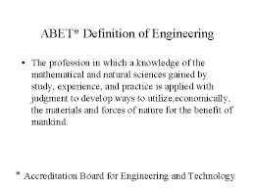
Engineering
This method is employed to create a novel model that allows a system to operate effectively, relying on predictions founded in probability, statistics, and calculus.
The procedure includes developing a model that processes data by leveraging knowledge of information technology alongside business acumen.
The aim is to handle substantial amounts of information, streamlining tasks by examining data and delivering it in a format that is easy to understand.

